Slide 1
Buy a Feature: an Adventure in Immutability and Actors
  David Pollak
  BayFP August 22, 2008

Slide 2
About Me
David Pollak
Writing commercial software since 1977
BDFL for the Lift Web Framework
Paying work:
  Enthiosys' Buy a Feature
  SAP's ESME project

Slide 3
About Buy a Feature (online)
The first of Enthiosys' online Innovation Games
Serious Gaming for Agile Product Management
Game Play:
  Create a list of product features with estimated costs
  4-8 player buy features that they want
  Motivate negotiations between players
  Learn how players sell each other on features

Slide 4
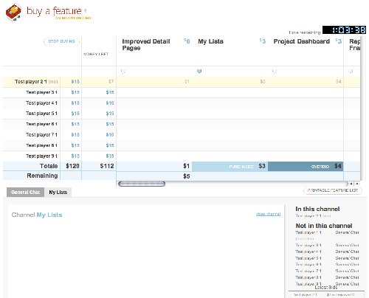
Buy a Feature

Slide 5
About Scala & Lift
Scala
  Hybrid OO & Functional Language
  Compiles to Java Byte-Code and runs fast on JVM
  Compatible with Java libraries
  FP concepts including Actors and Immutablity
Lift
  Concise, powerful web framework
  Leverages Scala's functional features
  Awesome Comet and AJAX support

Slide 6
Architecture
Lift based Comet front-end
UI state managed in Lift CometActors
All user interaction via JSON messages/events
Events sent to GameActor
GameActor updates GameBoard and writes events
GameActor sends GameBoard, etc. to CometActors

Slide 7
Actors – Why?
Excellent concurrency management
Event oriented
Asynchronous
case EndGame =>
recordGameEnding()
this ! ChatMessage(Empty, timeNow,
"Game Ended", Empty, Empty)
eachListener(_ ! EndGame)

Slide 8
Actors – Where?
UI
  Pushes UI state changes out to browser
  Listen for incoming events/messages
Cross-session Game managers
  Incoming events serialized
  Incoming events → New State
  New State → Listners (other Actors)

Slide 9
Events – Why?

Slide 10
Events – Where?

Slide 11
Post-Processing

Slide 12
Defects
Lift session bugs
  Lots of stupid problems working around J2EE sessions
  Why? I'm a moron
Browser Incompatibilites
Post-processing

Slide 13
Team Integration
Disbelief over code size
Attempts to dive below the abstractions
Java-like coding on the road to functional
Eventual adoption of map, fold, and filter
NPE: Thing of the past
Lack of tool support and examples in the wild are speed bumps, especially with existing code
Need a team mentor to help with transition

